Slide 1
Medical Insurance Price Prediction
Faculty Coordinator – Mrs.Subha Meenakshi.S
Team Members :-
Thejas B P –1BI20AI051
S Pranav-1BI20AI039

Slide 2

Abstract
Medical costs are a common and recurring expense influenced by lifestyle and physical factors. This study aims to link personal medical expenses with characteristics such as smoking, age, and BMI. Using linear regression models, we found that smoking, age, and higher BMI significantly contribute to increased medical expenditures, predicting charges with over 75% accuracy. As per the World Health Organization, healthcare spending is rising faster than the global economy, attributed to factors like smoking, aging, and higher BMI. Analyzing insurance data, we aim to unveil connections between medical costs and parameters like smoking, age, number of children, location, and BMI.

Slide 3
Introduction
Predicting medical insurance prices is a complex yet crucial task in the ever-evolving landscape of healthcare. As advancements in medical technology and changes in healthcare policies continue to influence the industry, understanding the factors that determine insurance costs becomes increasingly vital. By leveraging data analytics and machine learning techniques, we can delve into the intricate web of variables that contribute to medical insurance pricing. From demographic factors to individual health metrics, lifestyle choices, and prevailing economic conditions, a myriad of elements shapes the pricing landscape. This predictive analysis aims to unravel the intricacies of these factors, providing insights that not only benefit insurance providers in setting accurate premiums but also empower individuals to make informed decisions about their healthcare coverage. In this exploration of medical insurance price prediction, we navigate through the intersection of data science and healthcare economics to offer a glimpse into the future of insurance pricing.

Slide 4
Literature Survey
Sl.NO | Authors Name & Year of Publicaiton | Title Name and Journal Name | Abstract or objectives | Techniques Used | Limitations
1. | Ch. Anwar ul Hassan, Syed Sajid Ullah | A Computational Intelligence Approach for Predicting Medical Insurance Cost | Comparing the performance results of the most popular machine learning algorithms for forecasting the costs of healthcare insurance using a public dataset. | Linear Regression, Ridge Regressor, Support Vector Regression, XGBoost, Stochastic Gradient Boosting, Decision Tree, Random Forest Regressor, k-Nearest Neighbors, and Multiple Linear Regression. | The study does not provide a detailed explanation of the feature engineering process, which could affect the accuracy of the results.
2. | Mukund Kulkarni, Rahul | Medical Insurance Cost Prediction using Machine Learning | Analyze the relationship between various independent variables and the dependent variable, Evaluate the performance of the developed models and identify the most accurate model. | Multiple Linear Regression, Decision Tree Regression, Gradient Boosting Regression | The study only considers a limited number of independent variables, and there may be other factors that could impact medical insurance costs that were not included in the analysis.
3. | Ayushi Bharti, Lokesh Malik | Regression analysis and prediction of medical insurance cost | To manage assets and select appropriate plans for health insurance. To analyze the dataset and identify the attributes that play an important part in achieving higher precision. | Regression analysis, Correlation analysis Ridge Regression, Lasso Regression, Elastic Net. | Lack of external validation: The paper does not validate the model on an external dataset, which may limit its generalizability to other populations.
4. | Madhuri Thorat, Mohasin Patel, | Medical Insurance Cost Prediction Using Machine Learning | Explore the application of advanced statistical methods, machine learning algorithms, and deep neural networks to predict the cost of health insurance. Determine the most accurate and reliable predictions for health insurance claims. | Multiple linear regression, Gradient boosting regression | The study acknowledges the challenges associated with missing data and the potential bias in simple replacement methods

Slide 5
Proposed System
The Medical information and expenditures billed by health insurance companies are included in the data. It has 1338 rows of information with the following columns: age, gender, BMI, illnesses, smokers, and insurance costs.
In these features, insurance charge is a dependent variable and the remaining features are called independent variables.
In regression analysis, we need to predict the value of the dependent variable using independent variables. First, we collected the dataset and applied various data preprocessing methods.
Data preprocessing is a technique in which we can remove missing values in the data. Because of these missing values, it is not possible to apply machine learning algorithms. After removal of missing values, we need to apply label encoding, one hot encoding data to the categorical features.

Slide 6
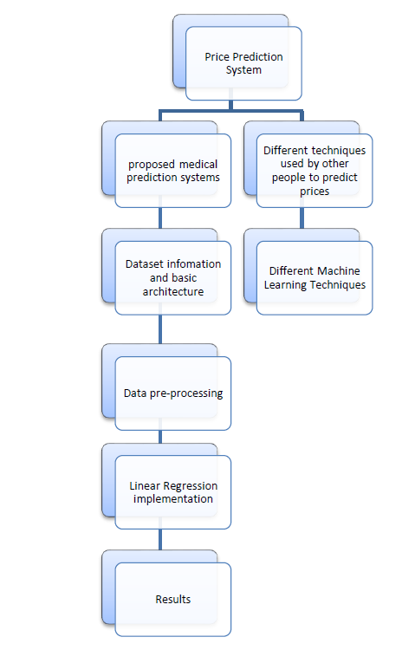
Data Preprocessing: The code performs data preprocessing for predicting insurance charges using a linear regression model. The dataset, is explored to check for missing values and understand feature distributions. Visualizations illustrate age, gender, BMI, children, smoking status, region, and charges. Categorical variables ('sex,' 'smoker,' 'region') are encoded numerically, and the dataset is split into training and testing sets. A linear regression model is trained and evaluated using R-squared values. The code concludes with an example predicting insurance charges for given input data.
Linear regression : Linear regression for medical insurance price prediction involves training a model on a dataset containing historical insurance claims, including premiums, demographics, health conditions, and lifestyle factors. Through feature engineering and numerical conversion, the model establishes relationships between these variables and insurance prices. Once trained, it provides a predictive equation, enabling users to input their information for an estimated insurance cost, aiding informed decision-making and plan comparison.

Slide 7
Linear Regression
1. Data Gathering: Train the model on a comprehensive dataset with historical insurance claims, including premiums, demographics, health conditions, medications, and lifestyle details.
2. Feature Engineering: Shape the data by converting categorical variables into numerical values and scaling numerical features for better model interpretation.
3. Model Training: Feed the prepared data into the linear regression algorithm, which identifies relationships between factors and insurance prices, creating a mathematical equation for predictions.
4. Model Evaluation: Assess the model's performance using metrics like mean squared error and R-squared to ensure accurate predictions, refining data or the algorithm if needed.
5. Putting it to Use: Once validated, input individual information into a user-friendly interface to obtain predicted insurance prices. This empowers users to compare options and make informed coverage decisions.

Slide 8
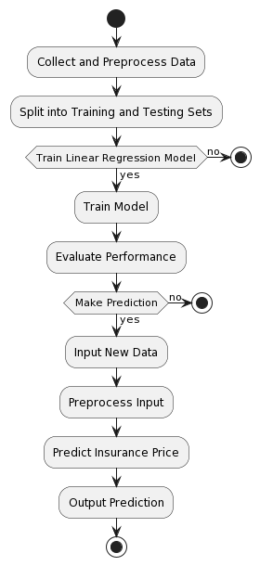
The first step is to collect and preprocess data, which may involve cleaning the data, removing outliers, and scaling the features.
The data is then split into training and testing sets. The training set is used to train the model, while the testing set is used to evaluate the performance of the model.
The model is trained using a linear regression algorithm. Once the model is trained, it is evaluated on the testing set.
If the performance of the model is good, then it can be used to make predictions on new data.
To make a prediction on a new data point, the data point must first be preprocessed. Then, the model is used to predict the insurance price for the data point.

Slide 9
System Requirements
Hardware Requirements:
Software Requirements:
-Jupyter Notebook
-Anaconda Navigator
-Python 3.8
-Linear Regression
-CPU : Processor i5 or more
-RAM : 8GB
-Operating System
Non Functional Requirements
Reliability:
The system should have high availability, with minimal downtime for maintenance or updates. The prediction model should have a high accuracy rate, minimizing false predictions.
The system should have automated backup and recovery processes to ensure data integrity.
Scalability:
The system should be designed to scale horizontally to accommodate a growing volume of data and users.

Slide 10
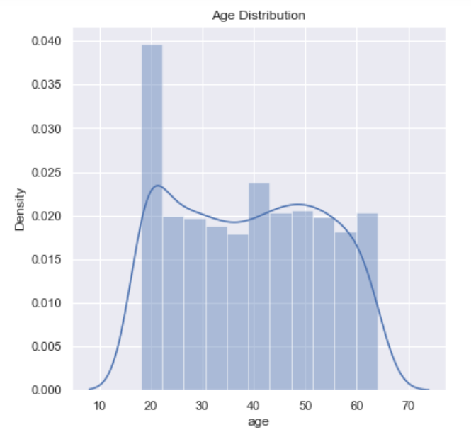
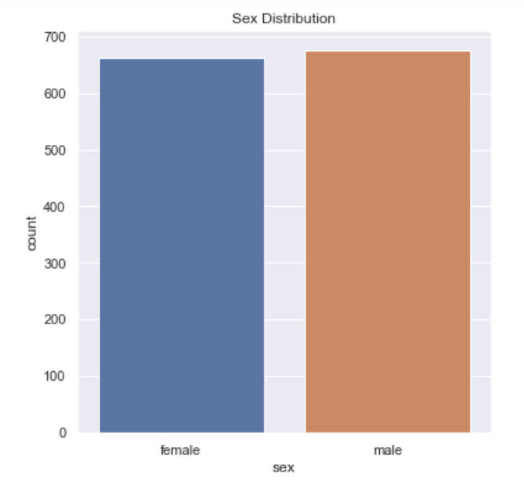
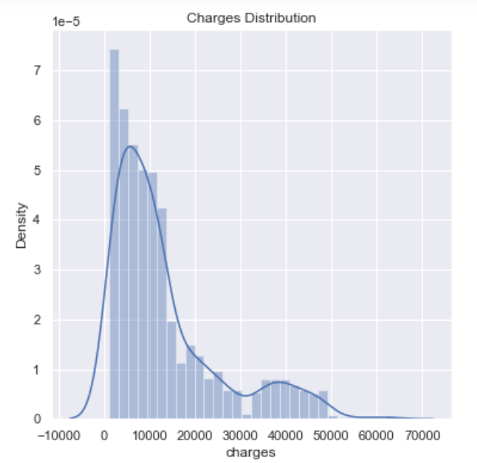
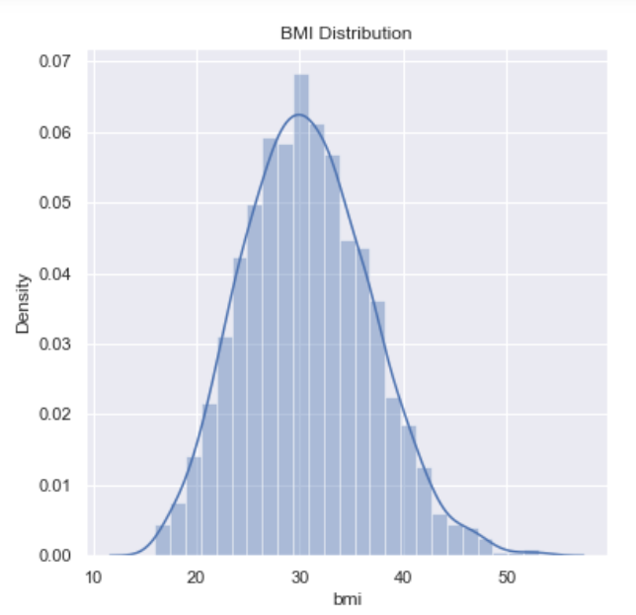
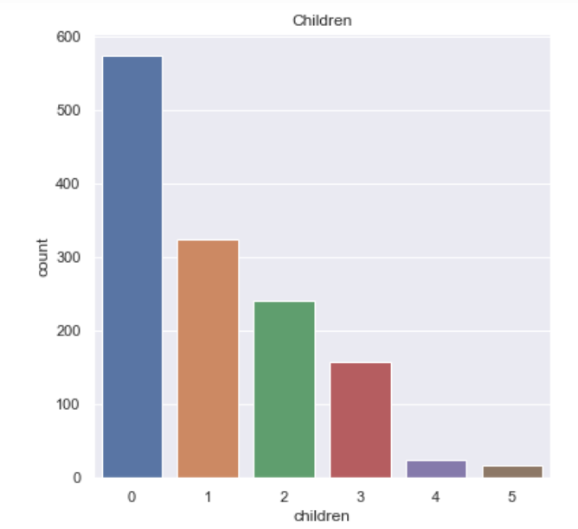
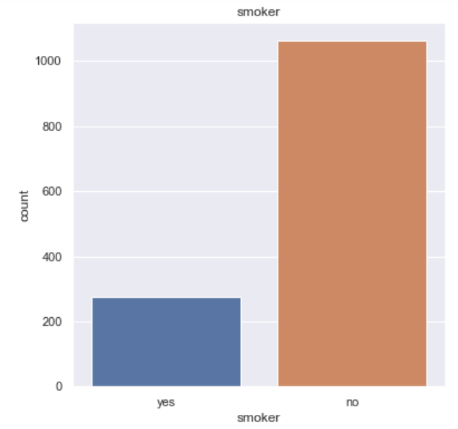

Slide 11
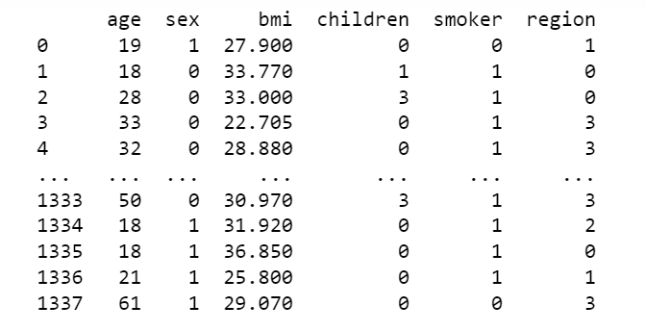
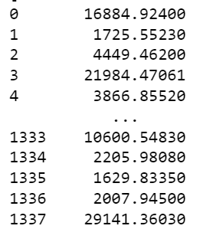

Slide 12
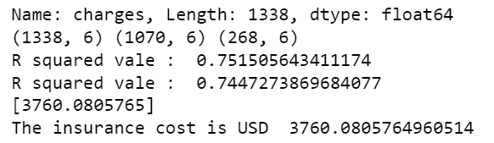

Slide 13
Thank You

